Slide 1
Simulation and Modeling
CSE4131_CSE4132

Slide 2
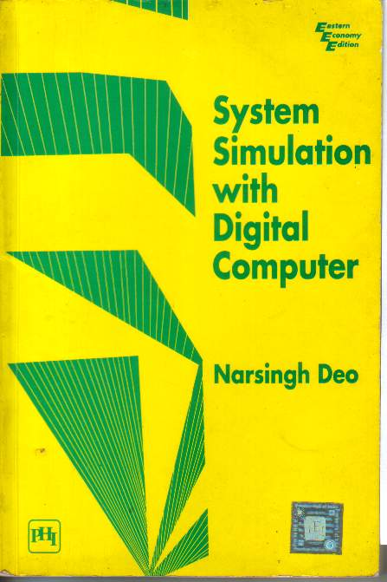
Recommended Book
System Simulation With Digital Computer
By Narshing Deo
Chapter 5: Simulation of a PERT network

Slide 3
What is PERT and CPM
PERT
The program (or project) evaluation and review technique, commonly abbreviated PERT, is a statistical tool, used in project management, which was designed to analyze and represent the tasks involved in completing a given project. It is commonly used in conjunction with the critical path method.
CPM
Critical Path Method
Before 1950 … no effective formal method … planning and schedule large project
1957 -1959… PERT and CPM … great help…in this regards.

Slide 4
CPM
The critical path method (CPM), which is a method used to estimate the minimum project duration and determine the amount of scheduling flexibility on the logical network paths within the schedule model. This schedule network analysis technique calculates the early start, early finish, late start, and late finish dates for all activities without regard for any resource limitations by performing a forward and backward pass analysis through the schedule network. The critical path is the sequence of activities that represents the longest path through a project, which determines the shortest possible project duration.

Slide 5
Network model of a project (2012)
Generally any nontrivial project can be thought of as consisting of a number of separate activities
For example:
Building construction → Selection of site + decision of architecture + laying of foundation + etc
Due to technical reasons:
Some activities can not be started before some others are complete
Thus there will be some PRECEDENCE RELATIONSHIP
In addition, each activity require certain time → DURATION

Slide 6
Network model of a project
The ACTIVITIES, the PRECEDENCE relationships, and DURATION of time can be represented by means of an arrow diagram Called an Activity Network or Activity Graph.
Activities are shown as: directed lines or edges
Also called branches or arrows or arcs.
And the nodes represents the beginning and completion of Activities → called: Event or milestones in the project

Slide 7
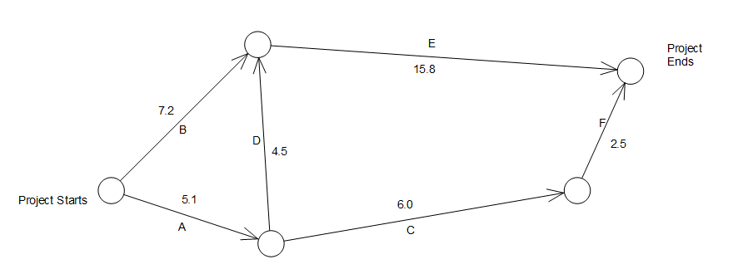
Network model of a project
An activity represented by edge (i,j)
can not be started before all activities leading to node i have been completed.
Let,… we have a project consisting of 6 well defined, non overlapping individual jobs. → A,B,C,D,E,F with the restriction
that
A must proceed C and D
B and D must proceed E
C must proceed F
i
j

Slide 8
Network model of a project
G
Dummy Activity:
Suppose we had an additional restriction that activity F can’t be initiated before completion of B and D were completed. We can incorporate this precedence relationship by drawing an additional edge G. Such an edge which represents only a precedence relationship and not any job in the project is called a dummy activity.
Dummy activities are necessary → when existing activities are not sufficient enough to describe relationship
Duration=0

Slide 9
Network model of a project
In-degree → no of edge entering a node
Out Degree → no. of edge going out…
In-degree = 2
Out-degree = 0
Sink Node
In-degree = 2
Out-degree = 1
In-degree = 0
Out-degree = 2
Source Node
In-degree = 1
Out-degree = 2

Slide 10
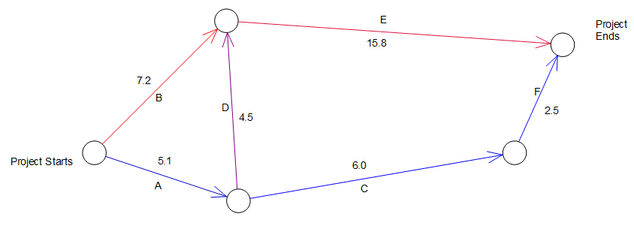
Analysis of activity network (2015)
Activity networks are analyzed by manager → optimizing the execution of project.
Path –A sequence of adjacent nodes from source to sink node is called :Path in a network
G (0)
ADE – is a path → length=5.1+4.5+15.8=25.4 days
ADGF– is a path →length=5.1+4.5+0+2.5 =12.1 days
ACF – is a path →length=5.1+6.0+2.5= 13.6 days
BGF – is a path →length=7.2+0+2.5= 9.7 days
BE – is a path →length=7.2+15.8= 23 days

Slide 11
Analysis of activity network
ADE – 25.4 days
ADGF –12.1 days
ACF – 13.6 days
BGF – 9.7 days
BE – 23 days
Critical Path → the longest path in a network…
Critical Activities → activities along with the critical path…
In a network there may be more than one critical path.
Use of critical path:
Find the project execution time
Any delay… execution of critical activities… delay the project

Slide 12
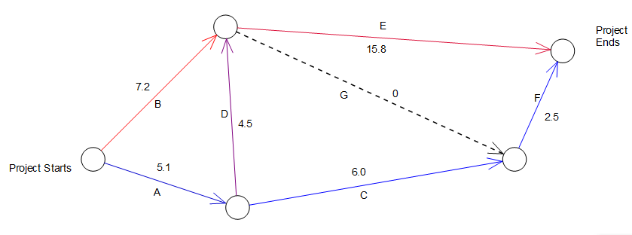
Topological Order
Topological Order → a list of activities … if no activity appears in the list before all of its predecessor have appeared.
A B C D E G F →Topological order
A B C D E F G →Not Topological order

Slide 13
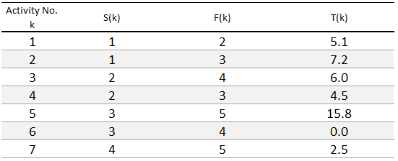
Finding Critical Path
Let, given activity network consist of :
N Activities (1,2….N)and
M Nodes (1,2…M)
Node 1 is the source node and M is the sink
In topological order
Starting Node of k^{th} activities
Finishing Node of k^{th} activities

Slide 14
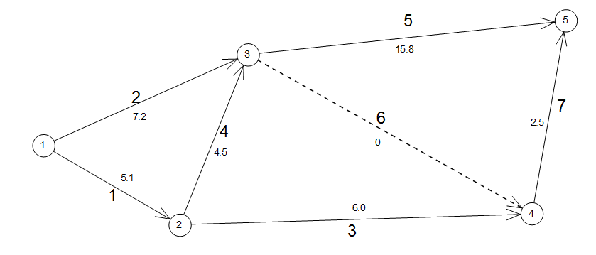
Finding Critical Path
Now find the critical path…

Slide 15
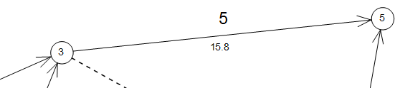
Finding Critical Path
K^{th} activity can’t begin …. Until
All activities terminating S(k) …. Completed
Earliest an activity k can begin … the last activity terminating in node S(k)
Let, EST (K) → earliest starting time for k^{th} activity
And EFT (k) → earliest finish time for k^{th} activity
Then
EFT(k) = EST(k) + T(k)

Slide 16
Finding Critical Path
All nodes → a milestone
A milestone i is said → Achieved → all terminating node to I completed
Let ENT(i) → earliest time when node i is achieved
Then
ENT(i) = Max { EFT (all activities terminating in i) } ----(5.2)
Since, EST (K) → earliest starting time for k^{th} activity
We can write EST(k)= ENT(S(k))

Slide 17
Forward Pass
ENT(i) → earliest time when node i is achieved
ENT(1)=0 Node 1’s achievement time=0
Since activity 1 begins @Node1
EST(1) = 0
EFT(1) = 0 + T(1)= 5.1
EFT(2) =0+T(2)= 7.2
Likewise, we compute all EFT’s for all activities originating @ Node1
ENT(i) = Max { EFT (all activities terminating in i) } -- ------- 5.2
Using this Eq. we can calculate ENT of next node.
ENT(2)=5.1 and ENT(3)=?

Slide 18
Forward Pass
For Nodes 1,2 and 3
ENT(1)=0
ENT(2)=5.1
ENT(3)=?
Calculate EST and EFT for some more activities
EST(4)=ENT(2)=5.1
EFT(4)=EST(4)+T(4)=5.1+4.5=9.6
ENT(3)= Max { EFT (all activities terminating in i) }
= Max{EFT(2), EFT(4)}= Max {7.2,9.6}
=9.6
This simple was possible because all activities was in topological order

Slide 19
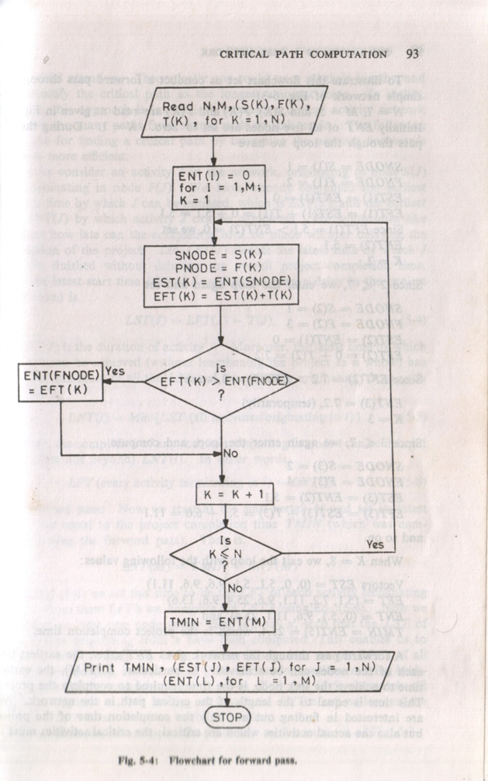

Slide 20
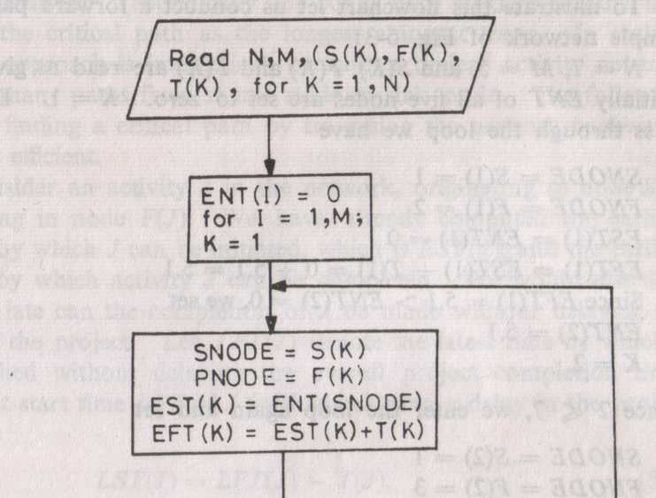
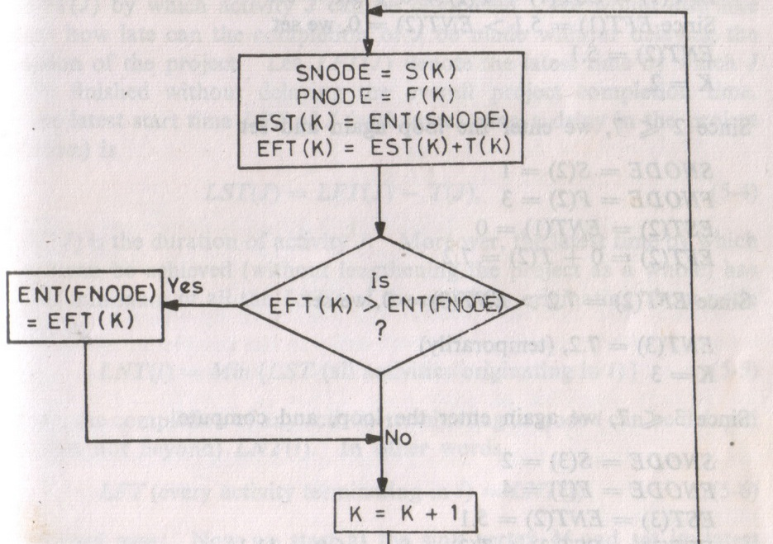
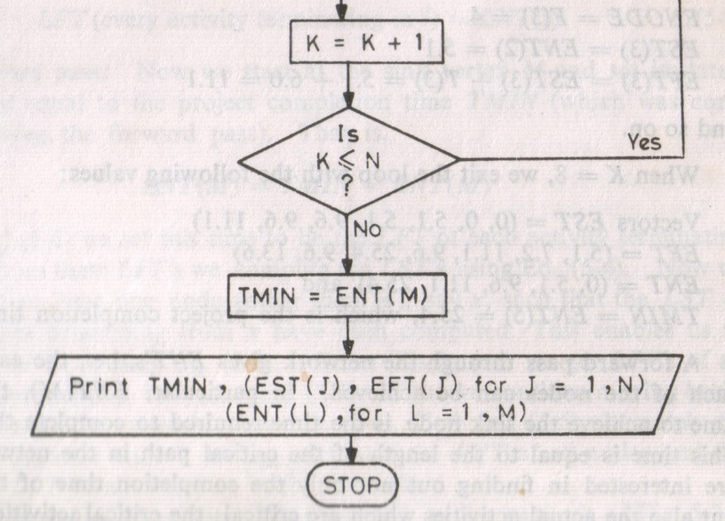
N Activities (1,2….N)and
M Nodes (1,2…M)
EST (K) → earliest starting time for k^{th} activity
EFT (k) → earliest finish time for k^{th} activity
ENT(i) = Max { EFT (all activities terminating in i) }

Slide 21
Programming Problem
Find Critical Path and Activities….

